Slide 1



Formation Big Data
Projet de Fin d’Etude
Olympic Games
Stagiaires
Houda OUALI ALAMI
Arthur TCHAMOKOUEN CHEPING
Grégoire RESVE
Romain ADANLETE
Responsables Formation
Mehdi TAZI
Razika BELHADDAD

Slide 2
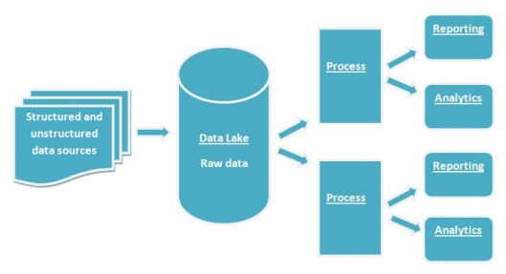
PFE Big Data : Olympic Games Athens 1896 - Rio 2016
Presentation
UC1-Ingestion
UC2-Dataviz
UC3-NoSQL
Demo

Slide 3
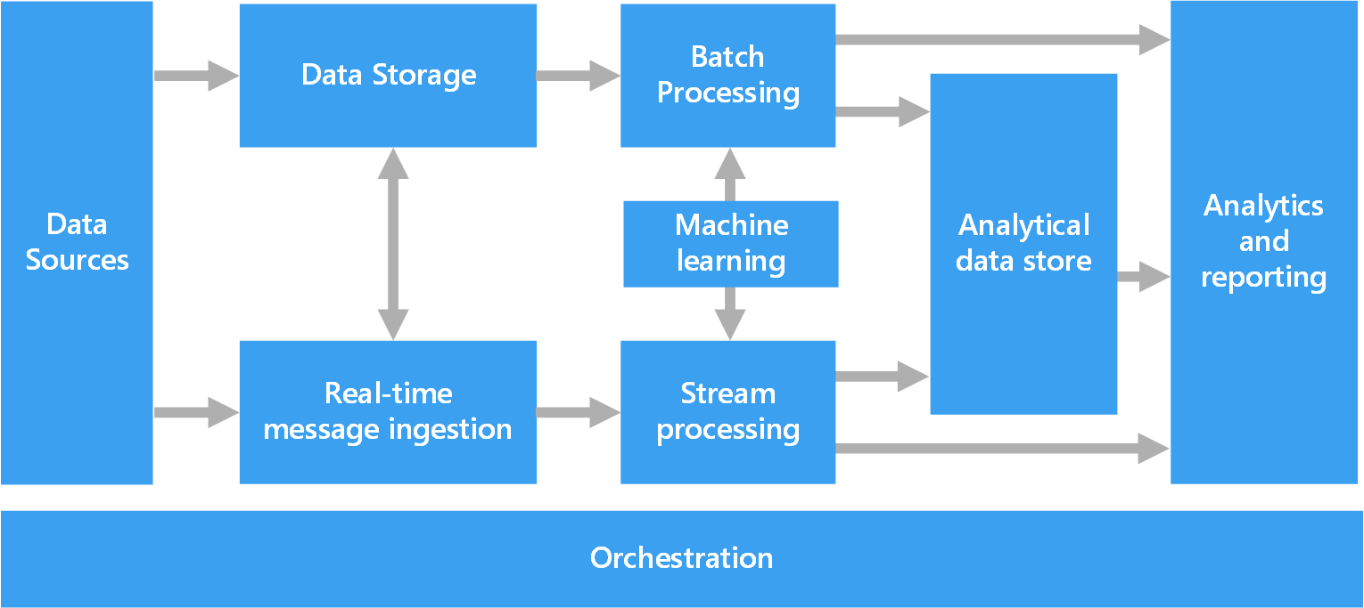
Principaux composants de l'architecture

Slide 4
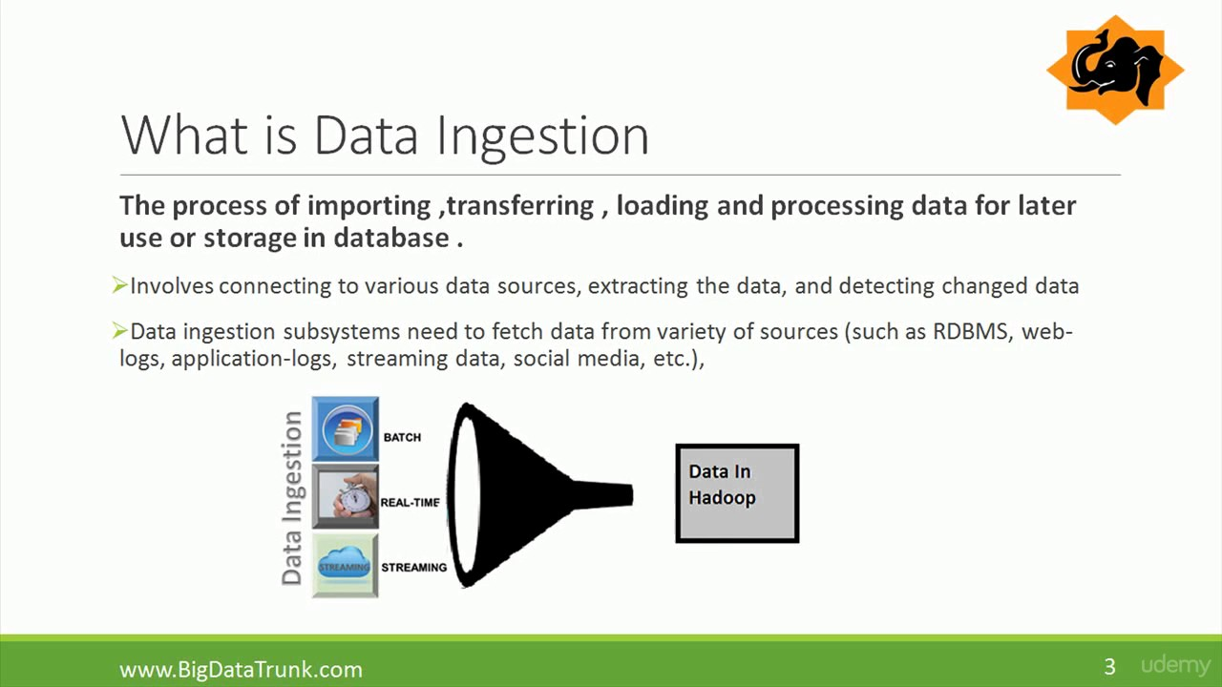
PFE Big Data : Olympic Games Athens 1896 - Rio 2016
UC1-Ingestion
UC2
UC3
Demo

Slide 5
UC1 – Datalake Architecture - Structures
1 - User (technical and ordinary users) Technical users creation In order to manage security and access concerns /user/<username> Ex: /user/dev_jo /user/arthur_t 2 - Application to run For applications management purpose /<env>/app/<projectname>/bin /<env>/app/<projectname>/oozie /<env>/app/<projectname>/oozie/coordinator /<env>/app/<projectname>/oozie/workflow/scripts | 3 - Data to store a - Raw data Place to store initial data without modification to ensure tracability /<env>/raw/<dataname>/data/version=current /<env>/raw/<dataname>/data/version=<YYYYMMDD> /<env>/raw/<dataname>/hive Ex: /dev/raw/JO/data/version=current /prd/raw/JO/data/version=20190709 b - Lake data Place to store processed data for BI usage /<env>/lake/<dataname>/data /<env>/lake/<dataname>/hive Ex: /dev/lake/JO/data/ /prd/lake/JO/data/hive

Slide 6

UC1 – Architecture - Processing workflow
Oozie is used as scheduler.
All tasks are executed via Oozie workflows.
Some are called using manual command (On Request).
Others are called via a workflow behind an Oozie coordinator.

Slide 7


UC1 – Architecture - File types
Different filetypes are used to process all tasks :
- CSV filetype to store native data (data without any change)
- PARQUET filetype to help on analytic queries (faster processing as
compared to other formats).

Slide 8

UC1 - Architecture - Tables
Two types of tables are created: external tables and managed tables
Hive is used to manage and query data already present in HDFS datalake:
External tables: they provide view on data already present. We can then easily request data. Ex: dev_lake_jo.jo_full_games
Managed(internal) tables: used to store calculated data. In these tables, the data will be reset for each recalculation. So, each time new data will be received, the table will be truncated and populated anew.
Example:
dev_lake_jo.jo_top5_male_female_last_games
dev_lake_jo.jo_top5_athletes_per_country

Slide 9

UC1 - Architecture - Technologies
Since a complex system is required to allow data exposure from our datalake many tools/technologies are used:
- HDFS Hadoop File Sytem for our datalake,
- Oozie for tasks scheduling,
- Hive to expose data,
- Scala/Spark to facilitate « complexe » ingestion,
- Shell scripts to carry out some processsings triggered via Oozie workflows.

Slide 10


UC1 – Scripts - Ingestion - Raw
As explained in previous slide, Scala/Hadoop FileSystem(Spark) is used to ingest data.
The files we have to ingest in the datalake are stored into a folder on our cluster.
Each data file contains information relating to same «year » and « season ».
The filename pattern is <year>-<season>.csv
Ex : 1896-Summer, 2014-Winter.
Each time the workflow will run and a file is found in the folder, it will be ingested in the raw space set in datalake.
If a same « year-season » already exists into raw, it will be archived into specific timeline (versionning)folder before the ingestion occurs.
The existing file into host is moved into « done » folder to avoid additional copy.
Path samples :
- Development environment HDFS: /dev/raw/JO/data/version=current/2016-summer/xxxxx.csv
- Archive environment : /data/raw/JO/data/version=20190709/2016-summer/xxxxx.csv
Schema: Appendix 1.1 (todo)
Notes:
Les fichiers traités par le processus d’ingestion sont mis dans le répertoire « done » afin de garder une traçabilité des fichiers traités et d’éviter de réingérer le fichier s’il était resté dans le répertoire.

Slide 11
UC1 – Scripts - Ingestion - Lake
Same here, Scala/Spark is used to transform csv files to parquet files type.
Each time the workflow runs, the parquet files will be replaced.
A path example : /dev/lake/JO/data/Games=2016-Summer/xxxxx.parquet
Schema: Appendix 1.2 (todo)
Notes:
Transformed files are stored into a specific folder on the cluster. This folder is « lake ».
The parquet files will be regenerated each time the workflow will run

Slide 12


UC1 – Scripts - Metric tables
Assuming data is available in the lake in parquet format:
First : create a Hive external table for the whole parket file storage
Second : create managed tables based on previous external table.
This will enable to generate new data, that is « Metric data ».
8 managed tables, one for each of the 8 metrics requested in UC1.
6 managed tables, one for each of the 6 BI metrics used in UC2.
Scripts : Appendix 1.3.1 - External table
Scripts : Appendix 1.3.2 - Managed tables

Slide 13

PFE Big Data : Olympic Games Athens 1896 - Rio 2016
UC1
UC2-Dataviz
UC3
Demo

Slide 14
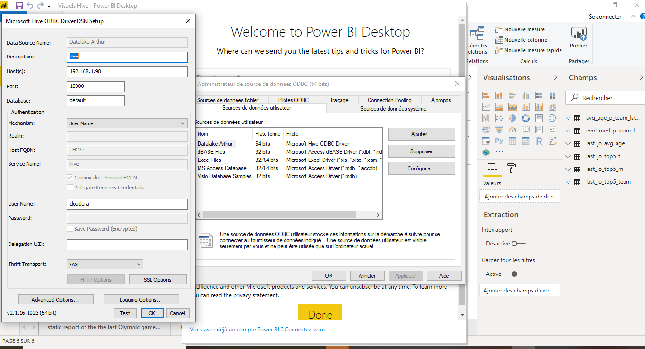

UC2 – Data Visualization
In order to load the data on which reports and charts are based,
we have connected the reporting tool Power BI on Hive platform using an ODBC connector .

Slide 15

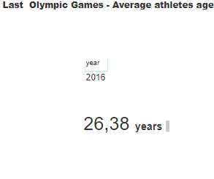
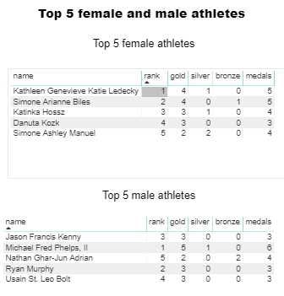
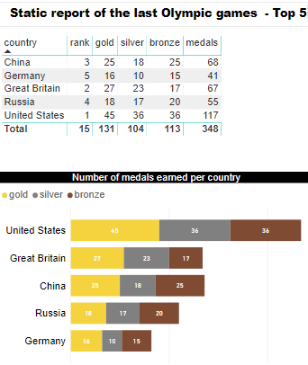
Static reports of the last Olympic Games

Slide 16
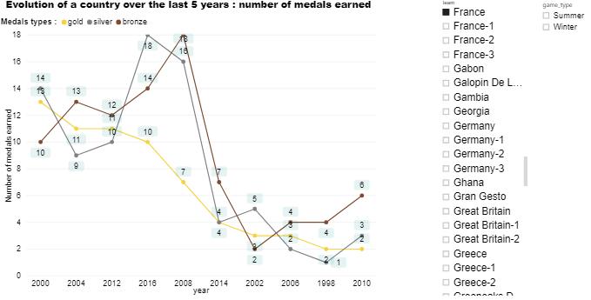
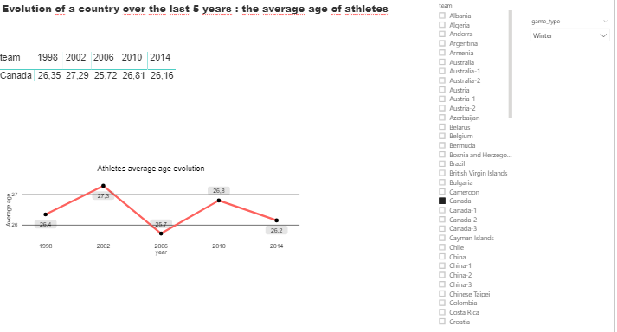
Dynamic charts showing evolutions of a country over the last 5 years

Slide 17
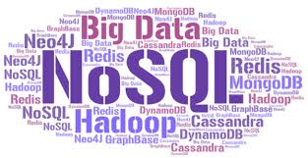
PFE Big Data : Olympic Games Athens 1896 - Rio 2016
UC1
UC2
UC3-NoSQL
Demo

Slide 18
UC3 – Database choice 1/2
Because lot of random R/W operations are done and because the volume is big but not very huge (less than Pbytes), we have chosen an Operational Database :
Both Relational database or NoSQL database are convenient.
To determinate what kind of databases we need, we have used the CAP principles.
As the tables are designed by query, NoSQL database are definitely more suitable.
Because Availability is not really required we can pick a database for which Partition Tolerance and Consistency requirements are fullfilled. In this case the databases range is somewhat wide : Cassandra, MongoDB, Hbase, CosmosDB etc.
The choice of the database was based on an selection matrix.
Notes:
Les modifications étant petites et nombreuses, plus la volumétrie relativement peu élevée, HDFS n’est pas adaptée. Perf.

Slide 19



UC3 – Database choice 2/2
To determinate which database to implement, we have used a multi criteria matrix.
According to the matrix in our context, the best choice is MongoDB Database.
 | Weight | MongoDB | Cassandra | Hbase
Cost | 1,5 | 4 | 4 | 5
Avaibility | 0,5 | 3 | 4 | 3,5
Consistency | 1 | 4 | 3 | 4
Language | 2 | 4 | 2,5 | 1
Total | 5 | 3,9 | 3,2 | 3,05

Slide 20
UC3 – Technologies
To help operational team to request our MongoDB database, we propose them different tools to manage (administration) collections and documents :
Terminal
Robo 3T
Studio 3T
Robo 3T is a free version. It’s easy to install and manipulate.
Notes:
A supprimer????

Slide 21
UC3 – Document Structures
To execute real R/W operations, our operational database should have documents which expose all fields for which modifications can be done.
As no restriction has been given, we consider the possibility to modify all fields (exept athlet ID).
The modifications occur only for the last game.
The Collection which stores our documents is named : JO.LastGames
The structure example can be found in Appendix 3.1

Slide 22
UC3 – MongoDB - Initial load scripts
We use Scala/Spark to copy data from datalake to our MongoDB collection.
Scripts consist in initiating a SparkSession with some settings relating to mongodb
.config("spark.mongodb.input.uri", "mongodb://localhost:27017/JO.LastGames")
.config("spark.mongodb.input.readPreference.name", "secondaryPreferred")
.config("spark.mongodb.output.uri", "mongodb://localhost:27017/JO.LastGames")
Once a dataframe is created using the same SparkSession based on source data, we transform it in RDD
Then the rdd is written into mongodb database using a specific class from :
import com.mongodb.spark.MongoSpark
Scripts : Appendix 3.2

Slide 23
UC3 – DesignByQuery Structure 1/2
Optimized document designed to return the list of the best athletes per country and per sport.
Used for research purpose and not for modification.
BestAthletesByCountryAndSport
ID | Integer
Name | String
City | List
Sport | String
Rank | Integer

Slide 24
UC3 – DesignByQuery Structure 2/2
Optimized document designed to return the list of athletes per range of weight (40-, 40-60, 60-80, 80-100,100+)
AthletesByWeightCategory
ID | Integer
Name | String
WeightRange | String

Slide 25

PFE Big Data : Olympic Games Athens 1896 - Rio 2016
UC1
UC2
UC3-NoSQL
Demo

Slide 26
Appendix

Slide 27
Appendix – 1.1
Script Scala/Spark tournant via la commande
spark-submit xxxxxxxx
Le script est lancé via la commande Oozie :
oozie job --oozie http://your_host:11000/oozie -config cluster_conf.xml -run

Slide 28
Appendix – 1.1.2 – Ingestion Run Command
Scala/Spark run command :
core/Scala/src/main/scripts/ingestion.sh: spark-submit
#!/bin/bash echo "starting at " spark-submit --conf spark.yarn.maxAppAttempts=1 --master yarn --deploy-mode cluster --executor-memory 1G --num-executors 2 /dev/app/JO/bin/PFE-JO-assembly-1.1.jar /dev/ftr/JO/data /dev/raw/JO/data /dev/lake/JO/data echo "ended at "

Slide 29
Oozie run command
core/Scala/src/main/oozie/workflow/workflow.xml : Workflow
<workflow-app xmlns="uri:oozie:workflow:0.4" name="jo-ingestion-wf"> <start to="shell-node"/> <action name="shell-node"> <shell xmlns="uri:oozie:shell-action:0.2"> <job-tracker>${jobTracker}</job-tracker> <name-node>${nameNode}</name-node> <exec>bash</exec> <file>${oozieScripts}</file> <capture-output/> </shell> <ok to="end"/> <error to="fail"/> </action> <kill name="fail"> <message> Shell action failed, error message[${wf:errorMessage(wf:lastErrorNode())}] </message> </kill> <end name="end"/> </workflow-app>

Slide 30
core/Scala/src/main/oozie/coordinator/coordinator.xml : Coordinateur

Slide 31
Folders and users structure
core/Scala/src/main/scripts/initApplicationStructure.sh : ApplicationStructure
core/Scala/src/main/scripts/initUserStructure.sh : UserStructure

Slide 32
Oozie run command : oozie job --oozie http://your_host:11000/oozie -config cluster_conf.xml -run
<workflow-app xmlns="uri:oozie:workflow:0.4" name="jo-ingestion-wf">
<start to="shell-node"/>
<action name="shell-node">
<shell xmlns="uri:oozie:shell-action:0.2">
<job-tracker>${jobTracker}</job-tracker>
<name-node>${nameNode}</name-node>
<exec>bash</exec>
<file>${oozieScripts}</file>
<capture-output/>
</shell>
<ok to="end"/>
<error to="fail"/>
</action>
<kill name="fail">
<message>
Shell action failed, error message[${wf:errorMessage(wf:lastErrorNode())}]
</message>
</kill>
<end name="end"/>
</workflow-app>

Slide 33
<coordinator-app xmlns="uri:oozie:coordinator:0.2"
frequency="${coord:days(1)}"
start="2019-09-27T06:00Z"
end="2019-09-30T23:59Z"
timezone="UTC"
name="jo_ingestion_coordinator" >
<controls>
<timeout>-1</timeout>
<concurrency>1</concurrency>
<execution>FIFO</execution>
<throttle>1</throttle>
</controls>

Slide 34
<action>
<workflow>
<app-path>${oozieWfApplicationXml}</app-path>
<configuration>
<property>
<name>jobTracker</name>
<value>${jobTracker}</value>
</property>
<property>
<name>nameNode</name>
<value>${nameNode}</value>
</property>
</configuration>
</workflow>
</action>

Slide 35
<coordinator-app xmlns="uri:oozie:coordinator:0.2"
frequency="${coord:days(1)}"
start="2019-09-27T06:00Z"
end="2019-09-30T23:59Z"
timezone="UTC"
name="jo_ingestion_coordinator" >
<controls>
<timeout>-1</timeout>
<concurrency>1</concurrency>
<execution>FIFO</execution>
<throttle>1</throttle>
</controls>
<action>
<workflow>
<app-path>${oozieWfApplicationXml}</app-path>
<configuration>
<property>
<name>jobTracker</name>
<value>${jobTracker}</value>
</property>
<property>
<name>nameNode</name>
<value>${nameNode}</value>
</property>
</configuration>
</workflow>
</action>
</coordinator-app>

Slide 36
Appendix – 1.2.1 – Full Games External Table Script
DROP TABLE IF EXISTS dev_lake_jo.jo_full_games;
CREATE EXTERNAL TABLE IF NOT EXISTS dev_lake_jo.jo_full_games(
ID String,
Name String,
Sex String,
Age String,
Height String,
Weight String,
Team String,
NOC String,
Year String,
Season String,
City String,
Sport String,
Event String,
Medal String
)
PARTITIONED BY (`games` String)
ROW FORMAT DELIMITED
STORED AS PARQUET
LOCATION '/dev/lake/JO/data';
MSCK REPAIR TABLE dev_raw_jo.jo_full_games;

Slide 37
Appendix – 1.2.2 – BI Managed Tables Script (1)
1 - Top 5 male/female athletes on last games
2 - Top 5 athletes per country
3 - Top 5 athletes per sport
create table if not exists dev_lake_jo.jo_top5_athletes_per_country
as
select * from (
select tt.Team,
tt.ID,
tt.Name,
concat(cast(floor(tt.sum_medal / 1000000) as string),' g, ',
cast(floor((tt.sum_medal % 1000000) / 1000) as string),' s, ',
cast(tt.sum_medal % 1000 as string),' b') as Medals,
row_number() over (partition by tt.Team order by tt.sum_medal desc) as rank
from (
select t.Team,
t.ID, t.Name,
sum(t.medal) as sum_medal
from (
select Team,
ID, Name,
case Medal
when 'Gold' then 1000000
when 'Silver' then 1000
when 'Bronze' then 1
else 0
end as medal
from dev_lake_jo.jo_full_games
where Medal != 'NA'
) t
group by t.Team, t.ID, t.Name
)tt
)ttt
where rank <= 5;
create table if not exists dev_lake_jo.jo_top5_athletes_per_sport
as
select * from (
select tt.Sport,
tt.ID,
tt.Name,
concat(cast(floor(tt.sum_medal / 1000000) as string),' g, ',
cast(floor((tt.sum_medal % 1000000) / 1000) as string),' s, ',
cast(tt.sum_medal % 1000 as string),' b') as Medals,
row_number() over (partition by tt.Sport order by tt.sum_medal desc) as rank
from (
select t.Sport,
t.ID, t.Name,
sum(t.medal) as sum_medal
from (
select Sport,
ID, Name,
case Medal
when 'Gold' then 1000000
when 'Silver' then 1000
when 'Bronze' then 1
else 0
end as medal
from dev_lake_jo.jo_full_games
where Medal != 'NA'
) t
group by t.Sport, t.ID, t.Name
)tt
)ttt
where rank <= 5;
create table if not exists dev_lake_jo.jo_top5_male_female_last_games
as
select ttt.ID as ID,
ttt.Name as Name,
concat(cast(floor(ttt.sum_medal / 1000000) as string),' g, ',
cast(floor((ttt.sum_medal % 1000000) / 1000) as string),' s, ',
cast(ttt.sum_medal % 1000 as string),' b') as Medals,
ttt.r as the_Rank
from (
select tt.ID, tt.Name,
tt.sum_medal,
row_number() over(order by tt.sum_medal desc) as r
from (
select t.ID, t.Name,
sum(t.medal) as sum_medal
from (
select ID, Name,
case Medal
when 'Gold' then 1000000
when 'Silver' then 1000
when 'Bronze' then 1
else 0
end as medal
from dev_lake_jo.jo_full_games g
where g.Games in (select max(gg.Games) from dev_lake_jo.jo_full_games gg)
and Medal != 'NA'
) t
group by t.ID, t.Name
) tt
)ttt
where ttt.r <= 5;

Slide 38
Appendix – 1.2.2 – BI Managed Tables Script (2)
4 - Top 5 contries per year
5 - Top 5 sports per contry
6 – Average athlete age per year
A ajouter
A ajouter
A ajouter

Slide 39
Appendix – 1.2.2 – BI Managed Tables Script (3)
7 – Number of medals per country
8 – Number of medals per athlete
A ajouter
create table if not exists dev_lake_jo.jo_number_different_medals_per_athlete
as
select ID, Name,
Medal,
count(Medal) number_medal
from dev_lake_jo.jo_full_games
where Medal != 'NA'
group by ID, Name, Medal;

Slide 40
Appendix – 2 – UC2 PowerBI Tables Script (1)
1 - Average athlete age on last games
2 - Top 5 female athletes on last games
3 - Top 5 male athletes on last games
CREATE TABLE IF NOT EXISTS dev_lake_jo.last_jo_avg_age STORED AS PARQUET AS SELECT C.year ,AVG(C.age) average_age FROM (SELECT A.year ,A.ID ,A.age FROM dev_lake_jo.jo_full_games A INNER JOIN (SELECT MAX(games) max_game FROM dev_lake_jo.jo_full_games) B ON A.games = B.max_game GROUP BY A.year,A.ID,A.age) C GROUP BY C.year ; | CREATE TABLE IF NOT EXISTS dev_lake_jo.last_jo_top5_f STORED AS PARQUET AS SELECT rank_global AS rank ,name ,gold ,silver ,bronze ,gold + silver + bronze AS medals FROM (SELECT B.* ,ROW_NUMBER() over (ORDER BY rank_medal DESC) rank_global ,CAST(rank_medal / 1000000 AS INT) AS gold ,CAST((rank_medal % 1000000) / 1000 AS INT) AS silver ,CAST(rank_medal % 1000 AS INT) AS bronze FROM (SELECT ID ,name ,SUM(medalscore) rank_medal FROM (SELECT ID ,name ,(CASE WHEN medal = "Gold" THEN 1000000 WHEN medal = "Silver" THEN 1000 WHEN medal = "Bronze" THEN 1 ELSE 0 END) AS medalscore FROM dev_lake_jo.jo_full_games A INNER JOIN (SELECT MAX(year) max_year FROM dev_lake_jo.jo_full_games) B ON A.year = B.max_year WHERE sex = "F" ) A GROUP BY ID,name ) B ) C WHERE rank_global <= 5 ; | CREATE TABLE IF NOT EXISTS dev_lake_jo.last_jo_top5_m STORED AS PARQUET AS SELECT rank_global AS rank ,name ,gold ,silver ,bronze ,gold + silver + bronze AS medals FROM (SELECT B.* ,ROW_NUMBER() over (ORDER BY rank_medal DESC) rank_global ,CAST(rank_medal / 1000000 AS INT) AS gold ,CAST((rank_medal % 1000000) / 1000 AS INT) AS silver ,CAST(rank_medal % 1000 AS INT) AS bronze FROM (SELECT ID ,name ,SUM(medalscore) rank_medal FROM (SELECT ID ,name ,(CASE WHEN medal = "Gold" THEN 1000000 WHEN medal = "Silver" THEN 1000 WHEN medal = "Bronze" THEN 1 ELSE 0 END) AS medalscore FROM dev_lake_jo.jo_full_games A INNER JOIN (SELECT MAX(year) max_year FROM dev_lake_jo.jo_full_games) B ON A.year = B.max_year WHERE sex = "M" ) A GROUP BY ID,name ) B ) C WHERE rank_global <= 5 ;

Slide 41
Appendix – 2 – UC2 PowerBI Tables Script (1)
4 - Top 5 countries on last games
5 – Evolution of medals per team on 5 last games per season
6 – Evolution of average age per team on 5 last games per season
CREATE TABLE IF NOT EXISTS dev_lake_jo.last_jo_top5_team STORED AS PARQUET AS SELECT rank_global AS rank ,team ,gold ,silver ,bronze ,gold + silver + bronze AS medals FROM (SELECT C.* ,ROW_NUMBER() over (ORDER BY rank_medal DESC) rank_global ,CAST(rank_medal / 1000000 AS INT) AS gold ,CAST((rank_medal % 1000000) / 1000 AS INT) AS silver ,CAST(rank_medal % 1000 AS INT) AS bronze FROM (SELECT team ,SUM(medalscore) rank_medal FROM (SELECT team ,(CASE WHEN medal = "Gold" THEN 1000000 WHEN medal = "Silver" THEN 1000 WHEN medal = "Bronze" THEN 1 ELSE 0 END) AS medalscore FROM (SELECT team, event, medal, games FROM dev_lake_jo.jo_full_games A INNER JOIN (SELECT MAX(games) max_games FROM dev_lake_jo.jo_full_games) B ON A.games = B.max_games GROUP BY team, event, medal, games) A ) B GROUP BY team ) C ) D WHERE rank_global <= 5 ; | CREATE TABLE IF NOT EXISTS dev_lake_jo.evol_med_p_team_lst5gms_p_seas STORED AS PARQUET AS SELECT game_type ,year ,team ,gold ,silver ,bronze FROM (SELECT C.* ,CAST(rank_medal / 1000000 AS INT) AS gold ,CAST((rank_medal % 1000000) / 1000 AS INT) AS silver ,CAST(rank_medal % 1000 AS INT) AS bronze FROM (SELECT game_type ,year ,team ,SUM(medalscore) rank_medal FROM (SELECT A.season AS game_type ,A.year ,A.team ,(CASE WHEN medal = "Gold" THEN 1000000 WHEN medal = "Silver" THEN 1000 WHEN medal = "Bronze" THEN 1 ELSE 0 END) AS medalscore FROM (SELECT team, event, medal, A.games, A.season, year FROM dev_lake_jo.jo_full_games A INNER JOIN (SELECT games ,season ,ROW_NUMBER() over (PARTITION BY season ORDER BY games DESC) rank_year FROM dev_lake_jo.jo_full_games GROUP BY games, season) B ON A.games = B.games AND A.season = B.season WHERE B.rank_year <= 5 GROUP BY team, event, medal, A.games, A.season, year) A ) B GROUP BY game_type, year, team ) C ) D | CREATE TABLE IF NOT EXISTS dev_lake_jo.avg_age_p_team_lst5gms_p_seas STORED AS PARQUET AS SELECT game_type ,year ,team ,AVG(age) average_age FROM (SELECT A.season AS game_type ,A.year ,A.team ,A.ID ,A.age FROM dev_lake_jo.jo_full_games A INNER JOIN (SELECT game ,season ROW_NUMBER() over (PARTITION BY season ORDER BY games DESC) rank_year FROM dev_lake_jo.jo_full_games GROUP BY games, season) B ON A.games = B.games AND A.season = B.season WHERE B.rank_year <= 5 GROUP BY A.season, A.year, A.team, A.ID, A.age ) A GROUP BY game_type, year, team

Slide 42
top5_countries_per_year - top5_sport_per_team
dev_lake_jo.jo_top5_countries_per_year
dev_lake_jo.jo_top5_countries_per_year
drop table if exists dev_lake_jo.jo_top5_countries_per_year; create table if not exists dev_lake_jo.jo_top5_countries_per_year As select * from ( select tt.Year, tt.Team, concat(cast(floor(tt.sum_medal / 1000000) as string),' g, ', cast(floor((tt.sum_medal % 1000000) / 1000) as string),' s, ', cast(tt.sum_medal % 1000 as string),' b') as Medals, row_number() over (partition by tt.Year order by tt. sum_medal desc) as rank from ( select t.Year, t.Team, sum(t.medal) as sum_meda from ( select Year, Team, case Medal when 'Gold' then 1000000 when 'Silver' then 1000 when 'Bronze' then 1 else 0 end as medal from (select Year, Team, Medal, Event from dev_lake_jo.jo_full_games where Medal != 'NA‘ group by Year, Team, Medal, Event) A ) t group by t.Year, t.Team )tt)ttt where rank <= 5;
drop table if exists dev_lake_jo.jo_top5_sport_per_team; create table if not exists dev_lake_jo.jo_top5_sport_per_team as select * from ( select tt.Team, tt.Sport, concat(cast(floor(tt.sum_medal / 1000000) as string),' g, ', cast(floor((tt.sum_medal % 1000000) / 1000) as string),' s, ', cast(tt.sum_medal % 1000 as string),' b') as Medals, row_number() over (partition by tt.Team order by tt.sum_medal desc) as rank from (select t.Team, t.Sport, sum(t.medal) as sum_medal from ( select Team, Sport, case Medal when 'Gold' then 1000000 when 'Silver' then 1000 when 'Bronze' then 1 else 0 end as medal from (select Year, Team, Medal, Event, Sport from dev_lake_jo.jo_full_games where Medal != 'NA‘ group by Year, Team, Medal, Event, Sport) A ) t group by t.Team, t.Sport )tt)ttt where rank <= 5;

Slide 43
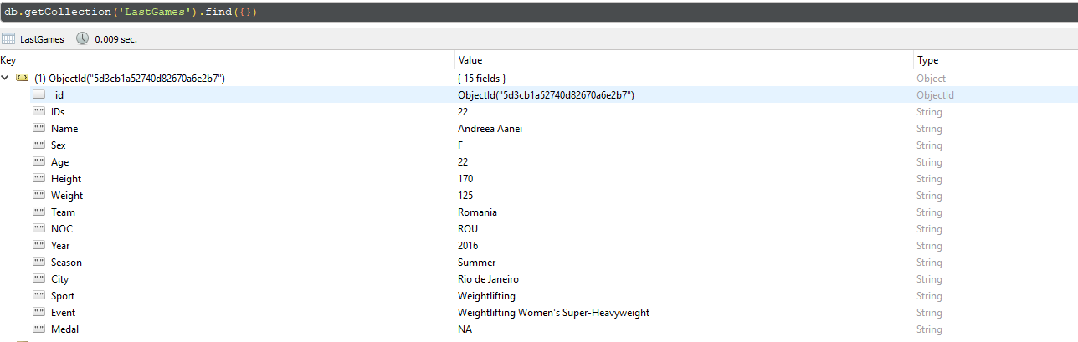
Appendix – 3.1

Slide 44
Appendix – 3.2 – MongoDB Ingestion
package fr.cegefos.pfe.controller import fr.cegefos.pfe.service.MongoDBWriter import org.apache.hadoop.conf.Configuration import org.apache.hadoop.fs.FileSystem import org.apache.log4j.{Level, Logger} import org.apache.spark.sql.SQLContext import org.apache.spark.{SparkConf, SparkContext} object ApplicationMongoDB { def main(args: Array[String]): Unit = { Logger.getLogger("org").setLevel(Level.ERROR) if (args.length == 0) { println("dude, i need at least one parameter") } else { val sparkConf = new SparkConf().setAppName("PFE Project - MongoDB") .setMaster("local") //TODO REMOVE FOR CLUSTER .set("spark.mongodb.input.uri", "mongodb://localhost:27017/JO.LastGames") .set("spark.mongodb.input.readPreference.name", "secondaryPreferred") .set("spark.mongodb.output.uri", "mongodb://localhost:27017/JO.LastGames") val sparkContext = new SparkContext(sparkConf) val sqlContext = new SQLContext(sparkContext) /* val sqlContext = SQLContext.builder() .config(sparkConf) .setMaster("local") .config("spark.mongodb.input.uri", "mongodb://localhost:27017/JO.LastGames") .config("spark.mongodb.input.readPreference.name", "secondaryPreferred") .config("spark.mongodb.output.uri", "mongodb://localhost:27017/JO.LastGames") .getOrCreate() */ val localConf = new Configuration() localConf.set("fs.defaultFS", "file://localhost") val localFS = FileSystem.get(localConf) val src = args(0) val mongoDBWriter = new MongoDBWriter(sqlContext, localFS) mongoDBWriter.start(src) } } } | package fr.cegefos.pfe.service import com.mongodb.spark.MongoSpark import org.apache.hadoop.fs.{FileStatus, FileSystem, Path} import org.apache.spark.rdd.RDD import org.apache.spark.sql.{DataFrame, Dataset, Row, SQLContext} import org.bson.Document class MongoDBWriter(var sqlContext:SQLContext, var localFS:FileSystem) { //Copy data from hdfs to MongoDB def start(inputPath: String) { //determine last games val status: Array[FileStatus] = localFS.listStatus(new Path(inputPath)) val srcPath = status.foldLeft(new FileStatus())((a: FileStatus, b: FileStatus) => if (a.toString().compareTo(b.toString) > 0) a else b ) val df: DataFrame = sqlContext.read.format("com.databricks.spark.csv").option("header", "true").option("quoteMode", "NONE").option("delimiter", ";").load(srcPath.getPath.toString) val lines: RDD[Row] = df.rdd lines.mapPartitionsWithIndex { (idx, iter) => if (idx == 0) iter.drop(1) else iter } val players: RDD[Document] = lines .map(line => line .toString() .replace(",]", "").replace("[", "") .split(",") ) .map(line => { val doc = new Document() doc.append("ID", line(0)) doc.append("Name", line(1)) doc.append("Sex", if (line.length > 2) line(2) else "") doc.append("Age", if (line.length > 3) line(3) else "") doc.append("Height", if (line.length > 4) line(4) else "") doc.append("Weight", if (line.length > 5) line(5) else "") doc.append("Team", if (line.length > 6) line(6) else "") doc.append("NOC", if (line.length > 7) line(7) else "") doc.append("Year", if (line.length > 8) line(8) else "") doc.append("Season", if (line.length > 9) line(9) else "") doc.append("City", if (line.length > 10) line(10) else "") doc.append("Sport", if (line.length > 11) line(11) else "") doc.append("Event", if (line.length > 12) line(12) else "") doc.append("Medal", if (line.length > 13) line(13) else "") doc }) //drop entire collection MongoSpark.write(df.filter("ID=-1")).mode("overwrite").save() MongoSpark.save(players) } }

